Slide 1
Database Analysis and Design Techniques
Unit III

Slide 2
Objective:
Phases in Database Development Life Cycle.
Relational Database Design:
Purpose of Normalization
The Process of Normalization

Slide 3
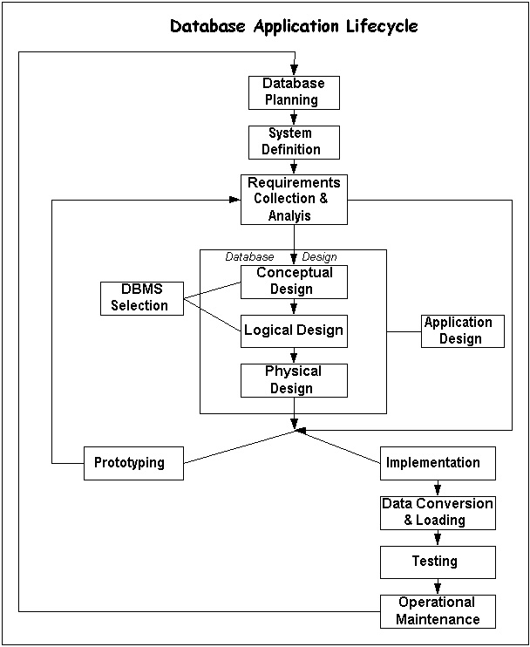
Database Development Life Cycle

Slide 4
Database Application Lifecycle
The database development process comprises a series of phases. The major phases in information engineering are:
Planning
System definition
Requirement Analysis
Application Design
DBMS Selection
Implementation
Maintenance

Slide 5

Database Planning
Focus here is on management activities
Activities include:
  Work to be done
  Resources available
Notes:
Designing the project and the needs of the project – assigning managerial/supervisor duties, identifying programmers needed and those available, determining the time-frame, etc

Slide 6
Database planning
The database-planning phase begins when a customer requests to develop a database project.
It is set of tasks or activities, which decide the resources required in the database development and time limits of different activities.
During planning phase, four major activities are performed.
Review and approve the database project request.
Prioritize the database project request.
Allocate resources such as money, people and tools.
Arrange a development team to develop the database project.
Database planning should also include the development of standards that govern how data will be collected, how the format should be specified, what necessary documentation will be needed.

Slide 7

System Definition
Scope
Parameters
Application areas
User groups
Notes:
Are we going to go for the full scope or start small. Eg, only efa indicators or more? One goal or more?
Who are the users needing this information?

Slide 8
Requirements Analysis
Requirements analysis is done in order to understand the problem, which is to be solved.
The person responsible for the requirements analysis is often called "Analyst".
In requirements analysis phase, the requirements and expectations of the users are collected and analyzed.
There are two major activities in requirements analysis.
Problem understanding or analysis
Requirement specifications.

Slide 9
Goals of Requirements Analysis
to determine the data requirements of the database in terms of primitive objects
to classify and describe the information about these objects
to identify and classify the relationships among the objects
to determine the types of transactions that will be executed on the database and the interactions between the data and the transactions
to identify rules governing the integrity of the data

Slide 10
Database design
The process of creating a design for a database that will support the enterprise’s operations and objectives

Slide 11
Database Design
In this phase, the information models that were developed during analysis are used to design a conceptual schema for the database and to design transaction and application.
In conceptual schema design, the data requirements collected in Requirement Analysis phase are examined and a conceptual database schema is produced.
In transaction and application design, the database applications analyzed in Requirement Analysis phase are examined and specifications of these applications are produced.

Slide 12
Database Design Framework
Determine the information requirements
Analyse the real-world objects that you want to model in the database
Determine primary key attributes
Develop a set of rules that govern how each table is accessed, populated and updated
Identify relationship between the entities
Plan database security
Notes:
The first step in the design process is to research the environment that you are trying to model. This involves interviewing prospective users and reviewing existing documents to understand the user requirements.

Slide 13
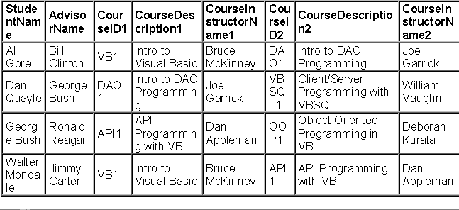
Students and courses
Notes:
This is an example of a flat file with data we want to store in the database.
If we wanted to add information about the advisor in this situation, we would have to create another flat file, and repeat the same information (name, school he works at, etc), so if something changes…
If we can somehow make the advisor’s information stand alone, yet link it somehow to the rest of the related data/……this is the concept behind relational databases

Slide 14
Identifying entities
Students
Courses
Instructors
StudentCourses
Advisors

Slide 15
Identifying attributes
What information on each entity should we know?
Students(student_id, Fname, lname, phone, advisor_id)
Advisors(Advisor_id, Advisorname, Advisorphone)
Instructors(instructor_id, Instructorname, Instructorphone)
StudentCourses(Student_id, Course_id)
Courses(Course_id, Coursedescription instructor_id)

Slide 16
DBMS Selection
In this phase an appropriate DBMS is selected to support the information system.
A number of factors are involved in DBMS selection. They may be technical and economical factors.
The technical factors are concerned with the suitability of the DBMS for information system.
The following technical factors are considered.
Type of DBMS such as relational, object-oriented etc
Storage structure and access methods that the DBMS supports.
User and programmer interfaces available.
Type of query languages.
Development tools etc.

Slide 17
Implementation
After the design phase and selecting a suitable DBMS, the database system is implemented.
The purpose of this phase is to construct and install the information system according to the plan and design as described in previous phases.
Implementation involves a series of steps leading to operational information system that includes creating database definitions (such as tables, indexes etc), developing applications, testing the system, developing operational procedures and documentation, training the users and populating the database.

Slide 18
Operational Maintenance
Once the database system is implemented, the operational maintenance phase of the database system begins.
The operational maintenance is the process of monitoring and maintaining the database system.
Maintenance includes activities such as adding new fields, changing the size of existing field, adding new tables, and so on.
As the database system requirement change, it becomes necessary to add new tables or remove existing tables and to reorganize some files by changing primary access methods or by dropping old indexes and constructing new ones.
Some queries or transactions may be rewritten for better performance.
Database tuning or reorganization continues throughout the life of database and while the requirements keep changing.

Slide 19
Relational Database Design
The goal of relational database design is to generate a set of schemas that allow us to Store information without unnecessary redundancy.
Retrieve information easily (and accurately).

Slide 20
Database Normalization
Normalization is a technique for producing a set of relations with desirable properties, given the data requirements of an enterprise.
The process of normalization is a formal method that identifies relations based on their primary or candidate keys and the functional dependencies among their attributes.

Slide 21
Purpose of Normalization
Main purposes of normalization in a relational database:
Eliminate redundancy
Organize data efficiently
Reduce the potential for data anomalies

Slide 22
Benefits of Normalization
Less storage space
Quicker updates
Less data inconsistency
Clearer data relationships
Easier to add data
Flexible Structure

Slide 23
Update Anomalies
Relations that have redundant data may have problems called update anomalies, which are classified as ,
Insertion anomalies
Deletion anomalies
Modification anomalies

Slide 24
Example of Update Anomalies
To insert a new staff with branchNo B007 into the StaffBranch relation;
To delete a tuple that represents the last member of staff located at a branch B007;
To change the address of branch B003.
StaffBranch
staffNo | sName | position | salary | branchNo | bAddress
SL21 | John White | Manager | 30000 | B005 | 22 Deer Rd, London
SG37 | Ann Beech | Assistant | 12000 | B003 | 163 Main St,Glasgow
SG14 | David Ford | Supervisor | 18000 | B003 | 163 Main St,Glasgow
SA9 | Mary Howe | Assistant | 9000 | B007 | 16 Argyll St, Aberdeen
SG5 | Susan Brand | Manager | 24000 | B003 | 163 Main St,Glasgow
SL41 | Julie Lee | Assistant | 9000 | B005 | 22 Deer Rd, London
Figure 1 StraffBranch relation

Slide 25
Example of Update Anomalies
Staff
staffNo | sName | position | salary | branceNo
SL21 | John White | Manager | 30000 | B005
SG37 | Ann Beech | Assistant | 12000 | B003
SG14 | David Ford | Supervisor | 18000 | B003
SA9 | Mary Howe | Assistant | 9000 | B007
SG5 | Susan Brand | Manager | 24000 | B003
SL41 | Julie Lee | Assistant | 9000 | B005
Branch
branceNo | bAddress
B005 | 22 Deer Rd, London
B007 | 16 Argyll St, Aberdeen
B003 | 163 Main St,Glasgow
Figure 2 Straff and Branch relations

Slide 26
Functional Dependencies
Identifying the primary key
Functional dependency is a property of the meaning or
semantics of the attributes in a relation. When a functional
dependency is present, the dependency is specified as a
constraint between the attributes.
An important integrity constraint to consider first is the
identification of candidate keys, one of which is selected to
be the primary key for the relation using functional dependency.

Slide 27
Functional Dependencies
Functional dependency describes the relationship between
attributes in a relation.
For example, if A and B are attributes of relation R, and B is
functionally dependent on A ( denoted A B), if each value of
A is associated with exactly one value of B. ( A and B may each
consist of one or more attributes.)
A
B is functionally
B
dependent on A
Determinant
Refers to the attribute or group of attributes on the left-hand side of the arrow of a functional dependency

Slide 28
The Process of Normalization
Normalization is often executed as a series of steps. Each step
corresponds to a specific normal form that has known properties.
As normalization proceeds, the relations become progressively
more restricted in format, and also less vulnerable to update
anomalies.
For the relational data model, it is important to recognize that
it is only first normal form (1NF) that is critical in creating
relations. All the subsequent normal forms are optional.

Slide 29
First Normal Form (1NF)
Repeating group = (propertyNo, pAddress, rentStart, rentFinish, rent, ownerNo, oName)
Unnormalized form (UNF)
A table that contains one or more repeating groups.
ClientNo | cName | propertyNo | pAddress | rentStart | rentFinish | rent | ownerNo | oName
CR76 | John kay | PG4 PG16 | 6 lawrence St,Glasgow 5 Novar Dr, Glasgow | 1-Jul-00 1-Sep-02 | 31-Aug-01 1-Sep-02 | 350 450 | CO40 CO93 | Tina Murphy Tony Shaw
CR56 | Aline Stewart | PG4 PG36 PG16 | 6 lawrence St,Glasgow 2 Manor Rd, Glasgow 5 Novar Dr, Glasgow | 1-Sep-99 10-Oct-00 1-Nov-02 | 10-Jun-00 1-Dec-01 1-Aug-03 | 350 370 450 | CO40 CO93 CO93 | Tina Murphy Tony Shaw Tony Shaw
Figure 3 ClientRental unnormalized table

Slide 30
Definition of 1NF
First Normal Form is a relation in which the intersection of each
row and column contains one and only one value.
There are two approaches to removing repeating groups from
unnormalized tables:
1. Removes the repeating groups by entering appropriate data
in the empty columns of rows containing the repeating data.
2. Removes the repeating group by placing the repeating data,
along with a copy of the original key attribute(s), in a separate
relation. A primary key is identified for the new relation.

Slide 31
1NF ClientRental relation with the first approach
The ClientRental relation is defined as follows,
ClientRental ( clientNo, propertyNo, cName, pAddress, rentStart, rentFinish, rent, ownerNo, oName)
With the first approach, we remove the repeating group
(property rented details) by entering the appropriate client
data into each row.
ClientNo | propertyNo | cName | pAddress | rentStart | rentFinish | rent | ownerNo | oName
CR76 | PG4 | John Kay | 6 lawrence St,Glasgow | 1-Jul-00 | 31-Aug-01 | 350 | CO40 | Tina Murphy
CR76 | PG16 | John Kay | 5 Novar Dr, Glasgow | 1-Sep-02 | 1-Sep-02 | 450 | CO93 | Tony Shaw
CR56 | PG4 | Aline Stewart | 6 lawrence St,Glasgow | 1-Sep-99 | 10-Jun-00 | 350 | CO40 | Tina Murphy
CR56 | PG36 | Aline Stewart | 2 Manor Rd, Glasgow | 10-Oct-00 | 1-Dec-01 | 370 | CO93 | Tony Shaw
CR56 | PG16 | Aline Stewart | 5 Novar Dr, Glasgow | 1-Nov-02 | 1-Aug-03 | 450 | CO93 | Tony Shaw
Figure 4 1NF ClientRental relation with the first approach

Slide 32
1NF ClientRental relation with the second approach
Client (clientNo, cName)
PropertyRentalOwner (clientNo, propertyNo, pAddress, rentStart, rentFinish, rent, ownerNo, oName)
With the second approach, we remove the repeating group
(property rented details) by placing the repeating data along with
a copy of the original key attribute (clientNo) in a separte relation.
ClientNo | cName
CR76 | John Kay
CR56 | Aline Stewart
ClientNo | propertyNo | pAddress | rentStart | rentFinish | rent | ownerNo | oName
CR76 | PG4 | 6 lawrence St,Glasgow | 1-Jul-00 | 31-Aug-01 | 350 | CO40 | Tina Murphy
CR76 | PG16 | 5 Novar Dr, Glasgow | 1-Sep-02 | 1-Sep-02 | 450 | CO93 | Tony Shaw
CR56 | PG4 | 6 lawrence St,Glasgow | 1-Sep-99 | 10-Jun-00 | 350 | CO40 | Tina Murphy
CR56 | PG36 | 2 Manor Rd, Glasgow | 10-Oct-00 | 1-Dec-01 | 370 | CO93 | Tony Shaw
CR56 | PG16 | 5 Novar Dr, Glasgow | 1-Nov-02 | 1-Aug-03 | 450 | CO93 | Tony Shaw
Figure 5 1NF ClientRental relation with the second approach

Slide 33
Full functional dependency
Full functional dependency indicates that if A and B are
attributes of a relation, B is fully functionally dependent on A if B is functionally dependent on A, but not on any proper subset of A.
A functional dependency A→B is partially dependent if there is some attributes that can be removed from A and the dependency still holds.

Slide 34
Second Normal Form (2NF)
Second normal form (2NF) is a relation that is in first normal form and every non-primary-key attribute is fully functionally dependent on the primary key.
The normalization of 1NF relations to 2NF involves the
removal of partial dependencies. If a partial dependency exists, we remove the function dependent attributes from
the relation by placing them in a new relation along with
a copy of their determinant.

Slide 35
2NF ClientRental relation
The ClientRental relation has the following functional
dependencies:
fd1 clientNo, propertyNo → rentStart, rentFinish (Primary Key)
fd2 clientNo → cName (Partial dependency)
fd3 propertyNo → pAddress, rent, ownerNo, oName (Partial dependency)

Slide 36
2NF ClientRental relation
After removing the partial dependencies, the creation of the three
new relations called Client, Rental, and PropertyOwner
Client (clientNo, cName)
Rental (clientNo, propertyNo, rentStart, rentFinish)
PropertyOwner (propertyNo, pAddress, rent, ownerNo, oName)
Client
Rental
ClientNo | cName
CR76 | John Kay
CR56 | Aline Stewart
ClientNo | propertyNo | rentStart | rentFinish
CR76 | PG4 | 1-Jul-00 | 31-Aug-01
CR76 | PG16 | 1-Sep-02 | 1-Sep-02
CR56 | PG4 | 1-Sep-99 | 10-Jun-00
CR56 | PG36 | 10-Oct-00 | 1-Dec-01
CR56 | PG16 | 1-Nov-02 | 1-Aug-03
PropertyOwner
propertyNo | pAddress | rent | ownerNo | oName
PG4 | 6 lawrence St,Glasgow | 350 | CO40 | Tina Murphy
PG16 | 5 Novar Dr, Glasgow | 450 | CO93 | Tony Shaw
PG36 | 2 Manor Rd, Glasgow | 370 | CO93 | Tony Shaw
Figure 6 2NF ClientRental relation

Slide 37
Third Normal Form (3NF)
Transitive dependency
A condition where A, B, and C are attributes of a relation such that
if A → B and B → C, then C is transitively dependent on A via B
(provided that A is not functionally dependent on B or C).
Third normal form (3NF)
A relation that is in first and second normal form, and in which
no non-primary-key attribute is transitively dependent on the
primary key.
The normalization of 2NF relations to 3NF involves the removal of transitive dependencies by placing the attribute(s) in a new relation along with a copy of the determinant.

Slide 38
3NF ClientRental relation
The functional dependencies for the Client, Rental and
PropertyOwner relations are as follows:
Client
fd2 clientNo → cName (Primary Key)
Rental
fd1 clientNo, propertyNo → rentStart, rentFinish (Primary Key)
fd5 clientNo, rentStart → propertyNo, rentFinish (Candidate key)
fd6 propertyNo, rentStart → clientNo, rentFinish (Candidate key)
PropertyOwner
fd3 propertyNo → pAddress, rent, ownerNo, oName (Primary Key)
fd4 ownerNo → oName (Transitive Dependency)

Slide 39
3NF ClientRental relation
The resulting 3NF relations have the forms:
Client (clientNo, cName)
Rental (clientNo, propertyNo, rentStart, rentFinish)
PropertyOwner (propertyNo, pAddress, rent, ownerNo)
Owner (ownerNo, oName)

Slide 40
3NF ClientRental relation
Client
Rental
ClientNo | cName
CR76 | John Kay
CR56 | Aline Stewart
ClientNo | propertyNo | rentStart | rentFinish
CR76 | PG4 | 1-Jul-00 | 31-Aug-01
CR76 | PG16 | 1-Sep-02 | 1-Sep-02
CR56 | PG4 | 1-Sep-99 | 10-Jun-00
CR56 | PG36 | 10-Oct-00 | 1-Dec-01
CR56 | PG16 | 1-Nov-02 | 1-Aug-03
PropertyOwner
Owner
propertyNo | pAddress | rent | ownerNo
PG4 | 6 lawrence St,Glasgow | 350 | CO40
PG16 | 5 Novar Dr, Glasgow | 450 | CO93
PG36 | 2 Manor Rd, Glasgow | 370 | CO93
ownerNo | oName
CO40 | Tina Murphy
CO93 | Tony Shaw
Figure 7 2NF ClientRental relation

Slide 41
Boyce-Codd Normal Form (BCNF)
BCNF is a higher version of the Third Normal form
This form deals with certain type of anomaly that is not handled by 3NF
Boyce-Codd normal form (BCNF)
A relation is in BCNF, if and only if, every determinant is a candidate key.
BCNF acts differently from 3NF only when there are multiple overlapping candidate keys.

Slide 42
3 NF vs BCNF
The difference between 3NF and BCNF is that for a functional dependency A → B, 3NF allows this dependency in a relation if B is a primary-key attribute and A is not a candidate key, whereas BCNF insists that for this dependency to remain in a relation, A must be a candidate key.
BCNF is stricter than 3NF
left side of any FD in the table must be a candidate key
3NF does not deal satisfactorily with the case of a relation with overlapping candidate keys i.e. composite candidate keys with at least one attribute in common

Slide 43
Table must have more than one candidate keys
Candidate keys must be composite
Candidate keys must be disjoint (overlapping)

